Slide 1
What is SRE and Why Every DevOps Professional Should Care
Dave Rensin
Director, Customer Reliability Engineering & Global Network Capacity Planning
@drensin
Notes:
(RENSIN)

Slide 2

How do we
improve reliability?
DevOps? or SRE?
Notes:
(LIZ)
image licensed by Google.

Slide 3





The Principles of DevOps
Reduce organizational silos
Accept failure as normal
Implement gradual changes
Leverage tooling and automation
Measure everything

Slide 4

Reliability is the most important feature.
Notes:
(RENSIN)
image licensed by Google.

Slide 5

Our users measure our reliability.
Notes:
Not our monitoring systems. Our user happiness is what matters.
image licensed by Google.

Slide 6

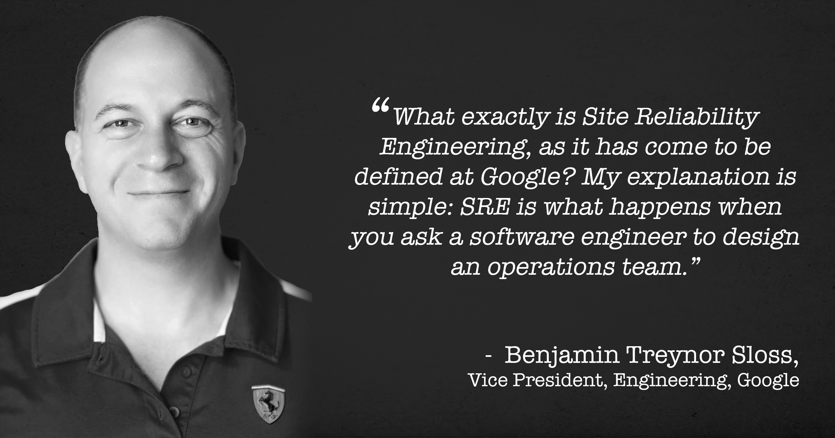
The Key Principle of SRE
100% is the wrong reliability target for basically everything.”
“
Benjamin Treynor Sloss
Vice President of 24x7 Engineering, Google
Notes:
The key realization that Ben Treynor Sloss, the founder of SRE at Google, had was that 100% is the wrong reliability target for everything.
Why? Because increases in reliability
cost exponentially more
slow you down by monopolizing your resources
have diminishing returns for users.
This is where error budgets come from.
Source: https://landing.google.com/sre/interview/ben-treynor.html

Slide 7
Availability level | Allowed unavailability window
 | per year | per quarter | per 30 days
90% | 36.5 days | 9 days | 3 days
95% | 18.25 days | 4.5 days | 1.5 days
99% | 3.65 days | 21.6 hours | 7.2 hours
99.5% | 1.83 days | 10.8 hours | 3.6 hours
99.9% | 8.76 hours | 2.16 hours | 43.2 minutes
99.95% | 4.38 hours | 1.08 hours | 21.6 minutes
99.99% | 52.6 minutes | 12.96 minutes | 4.32 minutes
99.999% | 5.26 minutes | 1.30 minutes | 25.9 seconds
Notes:
These familiar numbers help us describe the consequences of setting different availability levels
e.g., 99.9% target -> 43 minutes / month

Slide 8

Error budgets
Product management & SRE establish an availability target.
100% - availability target is a “budget of unreliability” (or the error budget).
Monitoring measures actual uptime.
Control loop for utilizing budget!
Notes:
To use as an error budget
establish the availability target
downtime allowance for that target, as described on the table we just saw, becomes the error budget.
need monitoring to measure the actual availability
difference between actual performance and target performance represents how much of the budget remains to be spent
Now we have data that can drive our reliability control loop, throttling our velocity vs. reliability investments to balance our budget!
image licensed by Google.

Slide 9
Glossary of terms
SLI
service level indicator: a well-defined measure of 'successful enough'
• used to specify SLO/SLA
• Func(metric) < threshold
SLO
service level objective: a top-line target for fraction of successful interactions
• specifies goals (SLI + goal)
SLA
service level agreement: consequences
• SLA = (SLO + margin) + consequences = SLI + goal + consequences
Notes:
And where does the SLO come in?
Put "availability target" through a thesaurus and turn it into a "service level objective"
The "availability metric" on which we base the needed monitoring turns into a "service level indicator"
The service level agreement is an important business extension of providing predictably reliable service to users, but for this talk we'll be focusing on SLI and SLO
---

Slide 10
The Practices of SRE
Metrics & Monitoring
Capacity Planning
Change Management
Emergency Response
Culture
SLOs
Dashboards
Analytics
Forecasting
Demand-driven
Performance
Release process
Consulting design
Automation
Oncall
Analysis
Postmortems
Toil management
Engineering alignment
Blamelessness

Slide 11

Why not both? SRE implements DevOps
Reduce organizational silos
Accept failure as normal
Implement gradual changes
Leverage tooling and automation
Measure everything
Error budgets & blameless postmortems
Reduce cost of failure
Automate common cases
Measure toil and reliability
Share ownership
Learn more at:
https://goo.gl/hTsZU3

Slide 12
Why Enterprises
SRE
Notes:
(LIZ)

Slide 13
Enterprises understand TCO and ROI
Run time >> development time.
Error budgets and SLOs prevent “intuition fatigue.”
Tools to both go faster and be more reliable un-paint executives from their corners.
Notes:
The older a company is, the more they have systems that have been running a long time. The understand that the long-term costs (and therefore returns) of a system are dominated by its operational burden. The lower the burden, the higher the ROI
Experienced CIOs and VPs understand the emotional fatigue that comes with making critical operational and feature decisions via intuition. It’s tiring, imprecise, and risky. They’re looking for a better way.
As these systems get older, the space for innovation shrinks because of operational growth. Any system that lets them recover that innovation space and keep reliability is a welcome godsend.

Slide 14
Enterprises appreciate cost savings.
Not just in dollars -- agility and opportunity costs
Incentives to reduce complexity.
Space for innovation matters.
Notes:
The older a company is, the more they have systems that have been running a long time. The understand that the long-term costs (and therefore returns) of a system are dominated by its operational burden. The lower the burden, the higher the ROI
Experienced CIOs and VPs understand the emotional fatigue that comes with making critical operational and feature decisions via intuition. It’s tiring, imprecise, and risky. They’re looking for a better way.
As these systems get older, the space for innovation shrinks because of operational growth. Any system that lets them recover that innovation space and keep reliability is a welcome godsend.

Slide 15
SRE manages risk.
SRE philosophy quantifies and mitigates risks
Regulated industries have audit and inspection requirements:
Financial Services
Healthcare
etc...
SRE unifies regulatory policy and operational principles.
Notes:
Regulators understand that 100% reliability or zero errors is unreasonable. What they want is a way to connect regulatory policy and risk regimes to operational principles -- which SRE happens to do really nicely.

Slide 16
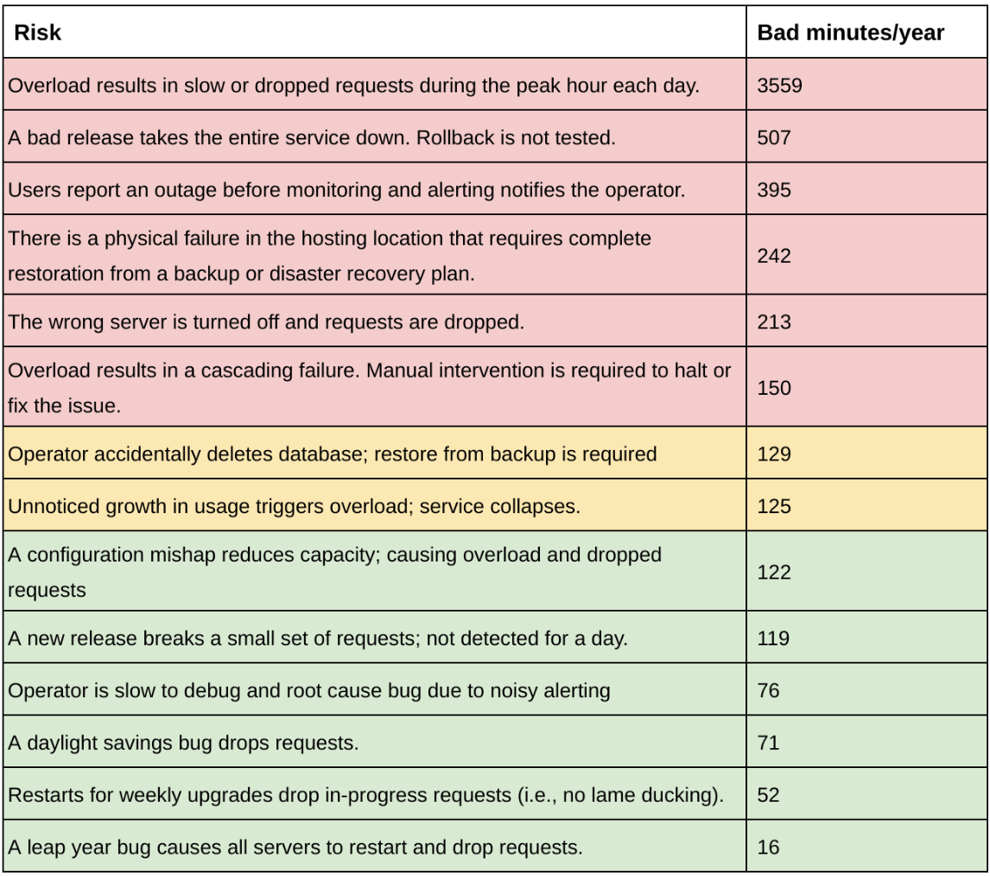

Risk Analysis #FTW!
SLO | 99.9%
Error Budget | 525.6 min/yr
You can play with this tool yourself at: https://goo.gl/bnsPj7
“You should describe how and when risk analysis was or will be performed. Your design validation procedure(s) should describe how you will document, use, and update your risk management program. For additional guidance on risk analysis and risk management activities, see the QS regulation preamble comment #83. [61 FR 52620-52621; see footnote 2.]”
-- Quality System Information for Certain Premarket Application Reviews; Guidance for Industry and FDA Staff
Notes:
Let’s look really quickly at an error budget analysis of some fictitious software system. It has an SLO of three nines, which means it has a yearly error budget of ~526min (43.2min per 30 days). The red items are risks that burn big chunks of the budget -- say >- 25%. You must fix those. The yellow, you should fix, but are survivable. The green don’t threaten your budget enough to worry about now. You can trade greens for yellows, maybe.
Now let’s look at what the US Food and Drug Administration requires for companies manufacturing health devices (emphasis, mine).
They don’t require a certain risk target, but they do require a systematic process for identifying, quantifying, and mitigating risks -- just like any SRE would!

Slide 17
SRE can be an easier lift
SRE is a concrete set of practices.
SRE provides a consistent and optimized way of implementing DevOps principles.
Executives can quantify and measure benefits.
Notes:
Regulators understand that 100% reliability or zero errors is unreasonable. What they want is a way to connect regulatory policy and risk regimes to operational principles -- which SRE happens to do really nicely.

Slide 18
How to start with SRE
Notes:
(RENSIN)

Slide 19
(#0) Willingness is the thing
It doesn’t matter from where you start, as long as you’re willing to do the work you can do SRE.
The ops and dev talent in an Enterprise are up to the task -- just align the incentives
A company doesn’t have to look anything like Google, Netflix, LinkedIn, etc to do it well.
Notes:
Here in Silicon Valley, Enterprises get a bad rap. They’re slow. They’re outdated. They don’t have the best engineers.. Etc.. Let’s bust a few myths, shall we?
The software engineering and operational talent in any large Enterprise is up to the task of adopting SRE. There might be skills gaps, but as long as they’re willing to close those, they can get it done. We’ve been consistently impressed with the level of talent in these companies. LOTS of talented people live and work outside of Silicon Valley. We should get over ourselves!
The key trait that predicts success is the willingness to go on the journey. Willingness of the execs to give air cover. Willingness of the dev and ops teams to lay down their arms.
SRE works in companies in all kinds of shapes and sizes. You don’t have to look like Google/Netflix/LinkedIn/etc to do this. Just ask The Home Depot. They don’t look anything like Google and they are awesome SREs!

Slide 20
(#0) In Practice -- Anonymized
A customer tried adopting SRE without a clear executive sponsor; the sponsor churned 3 times and the project stalled.
This would have been more successful with a written plan for successors to continually revise and execute and let it grow organically.
Note: “Executive sponsor” != “Executive mandate”

Slide 21
(#1) Do one application first
ap·pli·ca·tion
/ˌapləˈkāSH(ə)n/
Noun
noun: application; plural noun: applications; noun: application program; plural noun: application programs
A discrete failure domain
Notes:
Start with one discrete failure domain. Circumscribe the execs, devs, and ops folks who own it and get buy-in and success. Once everyone sees it working, they’ll want to do it, too! Caveat: Be sure to pick an app that is meaningful to the business. Non-business-important things (toys, tests, etc) won’t convey the lessons you want to teach.

Slide 22
(#1) In Practice -- Anonymized
An enthusiastic enterprise customer tried to transform whole org in place, and it was disastrous.
The best way to do this is one discrete failure domain at a time and let it spread organically. You can’t change an entire culture in one fell swoop.

Slide 23
(#2) Start with the Error Budget
If you can convince the exec, dev, and ops teams to create and stick to Error Budgets, then the rest (pretty much) takes care of itself
Notes:
the hardest thing we've found for other companies is to develop principled responses to "out of error budget": OK, you go to feature freeze. What now? Have to distinguish between tactical and strategic fixes e.g. is it OK to live with 2-4 months of expected outages if we have a strategic plan to remove our primary outage trigger after that?

Slide 24
(#2) In Practice -- Evernote
“Start the conversation from the point of view of your customers: what promises are you trying to uphold?”
“We kept our first pass simple by focusing on uptime. Using this simple first approach, we could clearly articulate what we were measuring, and how.”
“’Perfect is the enemy of good.’ Even when SLOs aren't perfect, they're good enough to guide improvements over time.”
“We selected an initial SLO that covered most, but not all, user interactions, which was a good proxy for quality of service.”
-- Ben McCormack (VP Operations / Chief of Staff -- Evernote)

Slide 25
(#2) In Practice -- The Home Depot
“[Before our] culture of SLOs, monitoring tools and dashboards were plentiful, but were scattered everywhere and didn’t track data over time.”
“We began troubleshooting at the user-facing service and worked backwards until we found the problem, wasting countless hours.”
“If a team needed to build a service, they wouldn’t know if the service they had a hard dependency on could support them. These disconnects caused confusion and mistrust.”
“Once SLOs were firmly cemented and effective automation and reporting were in place, new SLOs proliferated quickly. After tracking SLOs for about 50 services at the beginning of the year, by the end of the year we were tracking SLOs for 800 services, with about 50 new services being registered per month.”
-- William Bonnell (Sr. Director, SRE -- The Home Depot)

Slide 26
(#3) Alerting/Monitoring & Ops Load
TL;DR:
More logging and measurement is (probably) better;
More alerting is (probably) not!
Symptoms of pain, not infinite potential causes.
Focus on Observability.
Notes:
(LIZ)
Log whatever you want, but only alert on symptoms -- not causes. In practice, you’ll wind up turning off ~½ your alerts, which is a cheap way to dramatically reduce your toil and create space for value-add projects.

Slide 27

(#4) Blameless culture
We will always be reacting to the same kinds of failures over and over unless we invest in discovering what happened. we really ought to get something out of every error, rather than wasting the opportunity.
Can't get to culture of being able to take risks if we're blameful
Blame guarantees deceit!
(see why at: https://goo.gl/RBdYwc or )

Slide 28
Don't try it all at once
One step at a time…
Define SLIs, SLOs, and Error Budgets
Audit and adjust monitoring and alerting
Model and reward blameless postmortems
“Introducing a new process, let alone a new culture, to a large company takes a good strategy, executive buy in, strong evangelism, easy adoption patterns, and--most of all--patience. It might take years for a significant change like SLOs to become firmly established at a company. We'd like to emphasize that The Home Depot is a traditional enterprise; if we can introduce such a large change successfully, you can too. You also don't have to approach this task all at once. While we implemented SLOs piece by piece, developing a comprehensive evangelism strategy and clear incentive structure facilitated a quick transformation--we went from 0 to 800 SLO-supported services in less than a year.”
-- William Bonnell (Sr. Director, SRE -- The Home Depot)
Notes:
(RENSIN)
SLOs and Error Budgets are the currency of SRE. You have to start there. If that’s as far as you get, you’re still much better off.
Restricting your alerting to just the things that threaten the SLOs will reduce a huge amount of toil and, in turn, make your teams more productive and happier.
SRE is a culture as much as it is a set of principles and practices. The notion of a truly blameless postmortem is a big shift for large organizations, but it’s one they really want to take. You just need to model it for them!

Slide 29
You can do this.
Incremental progress buys time.
Any progress is time well spent.
Leave lots of on/off-ramps
It’s OK to stop for a while and come back when they’re ready.
Your teams can do this.

Slide 30
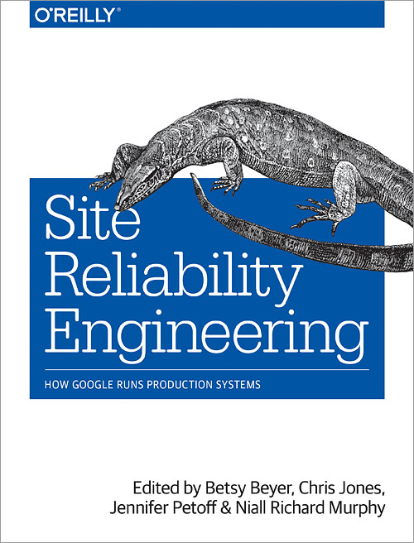
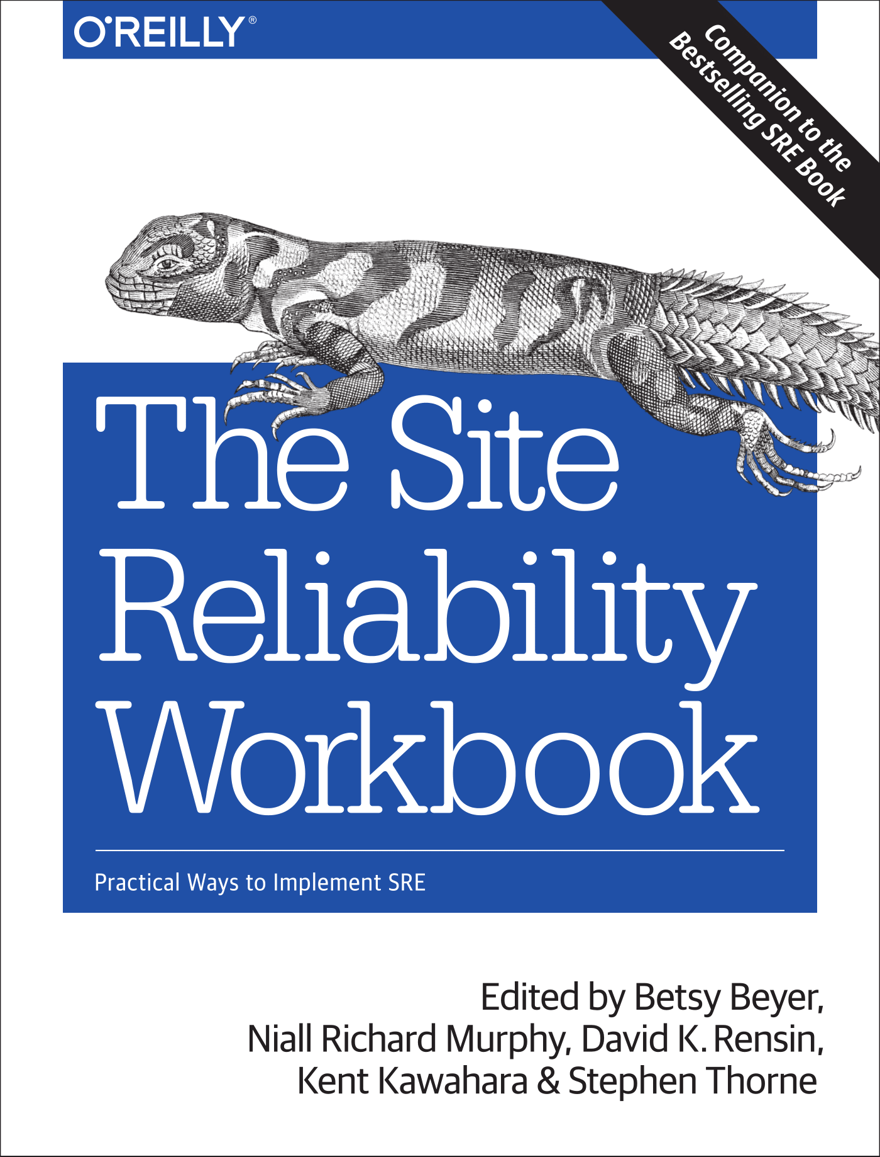
google.com/sre
Cover images used with permission. These books can be found on shop.oreilly.com.
Notes:
The original SRE book discusses the principles of SRE in depth.
The workbook extends those principles into practice (think: implementation details)
Seeking SRE is perspective from (mostly) non-Googlers

Slide 31
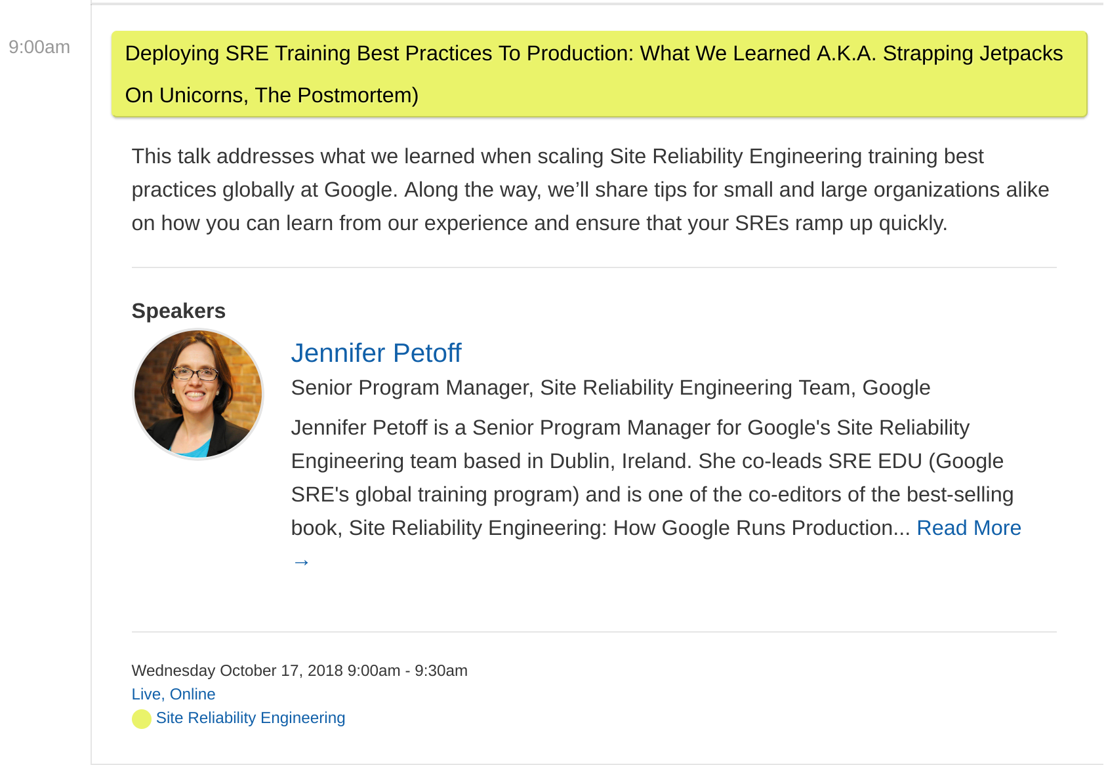
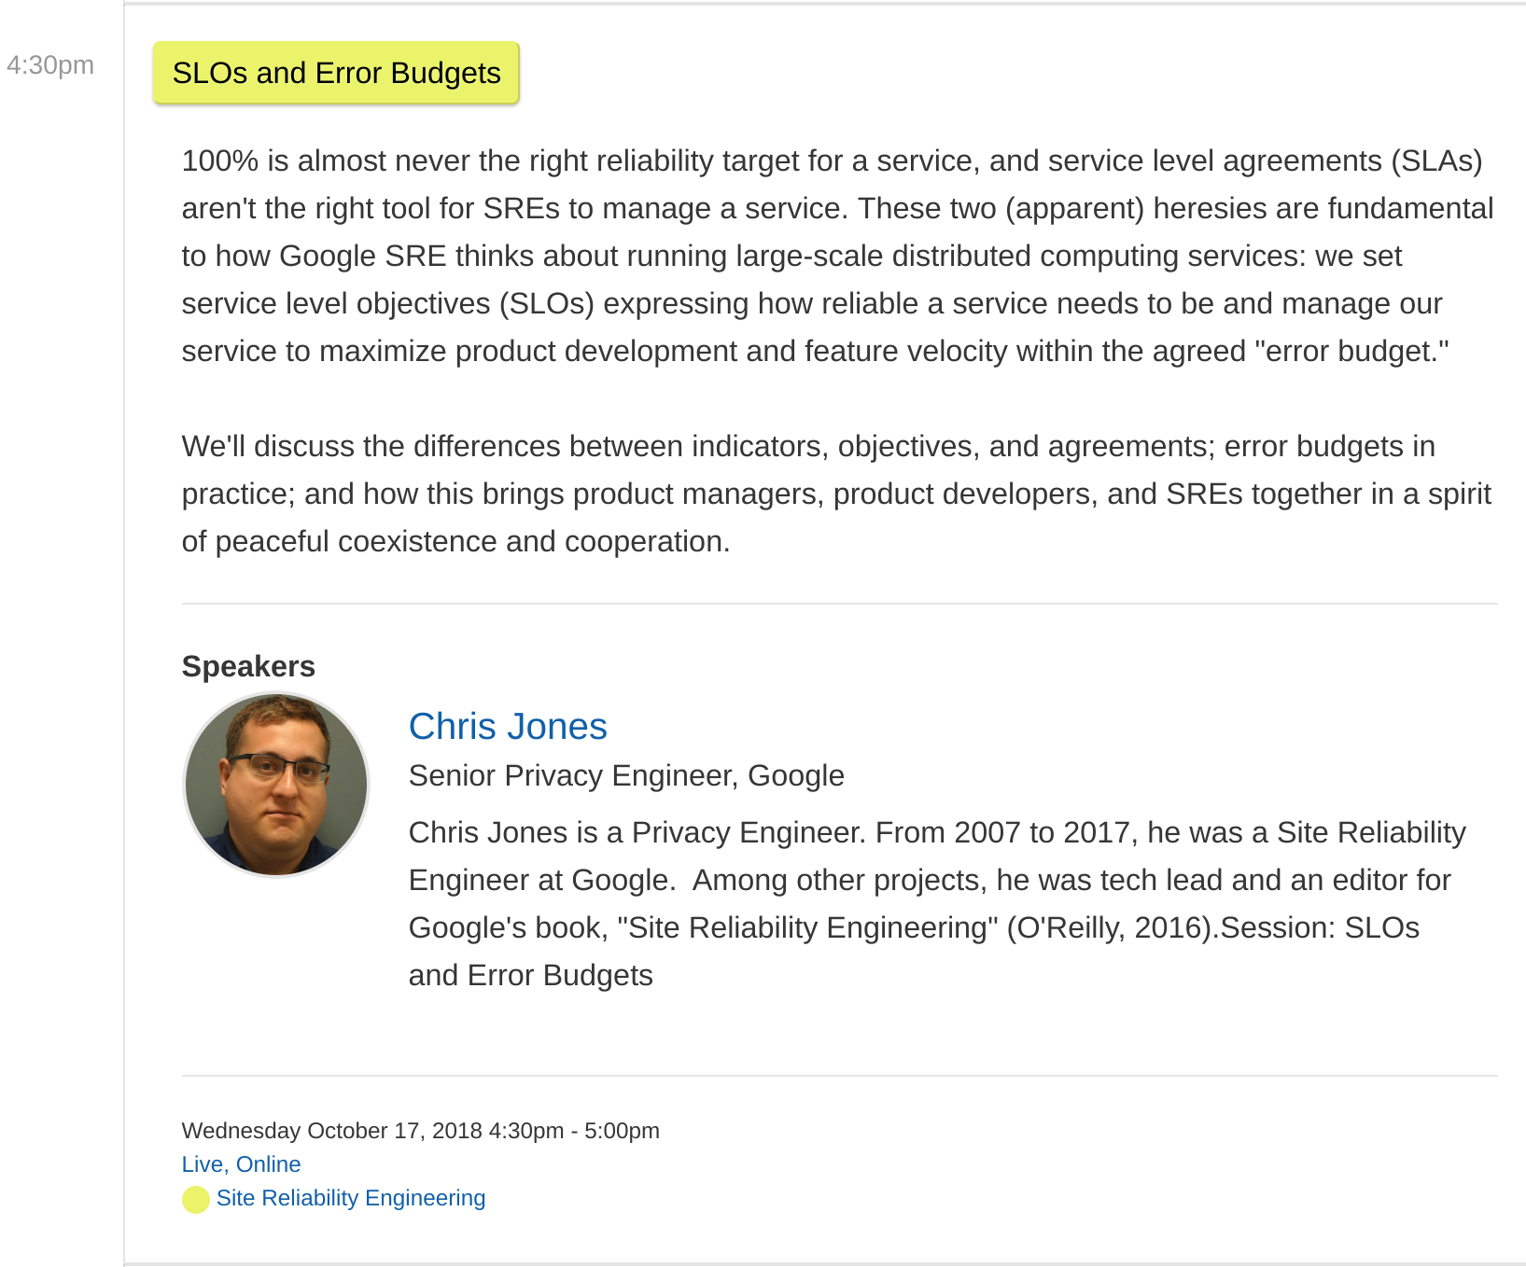
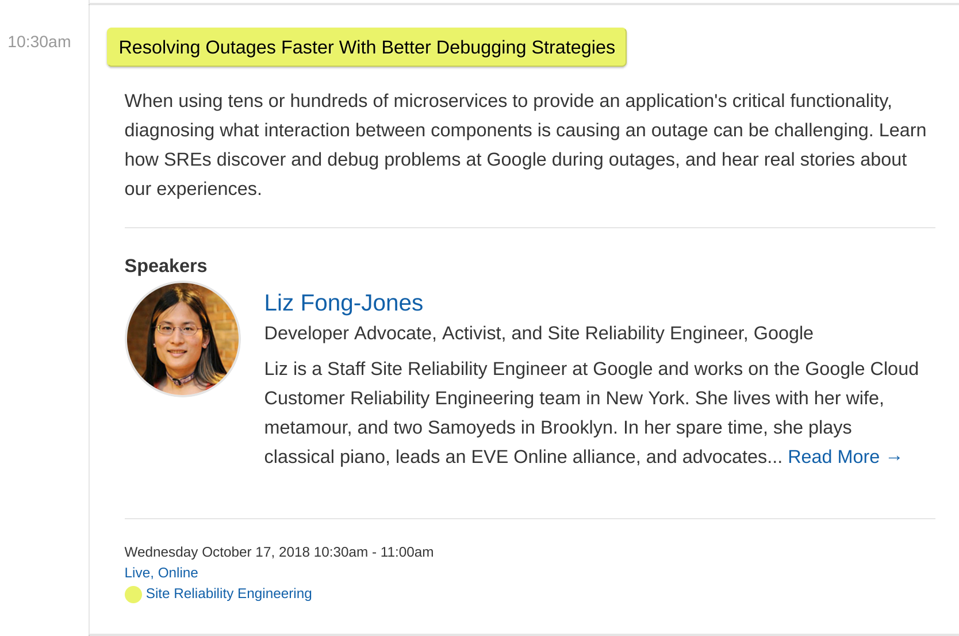
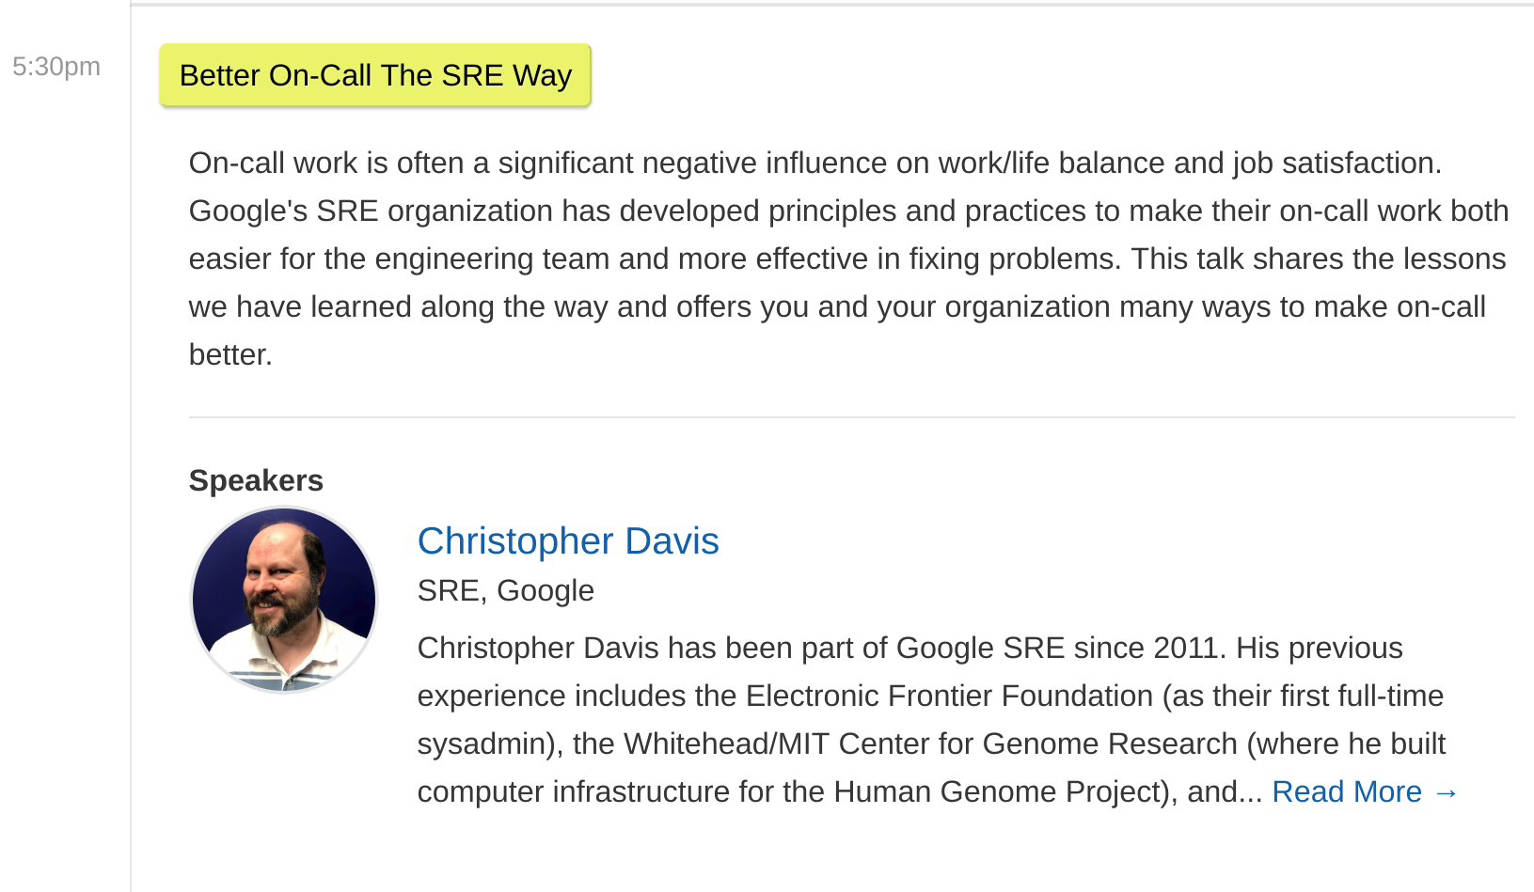
Other Googler talks
Notes:
(LIZ)

Slide 32
Thank You!
(I’ll be in the SRE Slack channel -- #2018addo-keynotes -- for Q&A
or @drensin on your social media platform of choice)

